Slide 1
PowerPoint Presentation
Mr. Cody Dick

Slide 2
How to find the Slide show Record Button
Start by making your slide show
Second Click the Slide Show tab
Third Click Record Slide Show

Slide 3
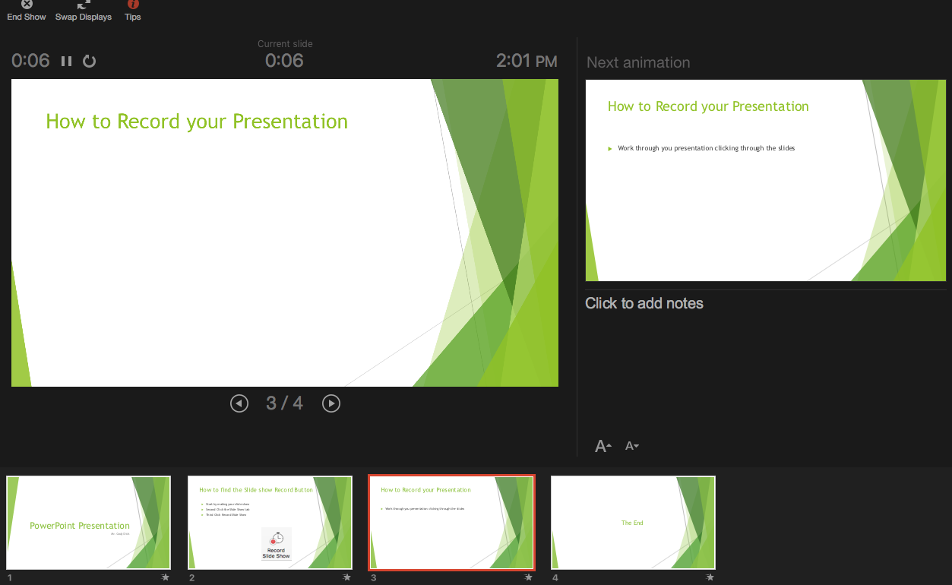
How to Record your Presentation
Work through you presentation clicking through the slides

Slide 4
Review your Presentation
Click the Play from Start on the Slide Show tab
If you don’t like something redo your presentation.

Slide 5
The End

